Slide 1

Reliance Stock forecasting
Group -4
MENTOR
Madishetti Rajshekhar
Group Members:
Mr.Rohit Vasant Gaikwad
Mr. Naresh Kulunge
Mr. Pritam Paul
MISS. Karthika D
Miss. Tejashri Anil Sawant
Mr. JEYAKANNA S

Slide 2
Business Problem:
Predict the Reliance Industries Stock Price for the next 30 days.
Objective:
Predict the Reliance Industries Stock Price for the next 30 days.
There are Open, High, Low and Close prices that you need to obtain from the web for each day starting from 2015 to 2022 for Reliance Industries stock.
Split the last year into a test set- to build a model to predict stock price.
Find short term, & long term trends.
Forecast for next 30 days.

Slide 3
Project Architecture / Project Flow
EDA
Splitting Data
Model Building
And Evaluation
Conclusion
Deployment

Slide 4
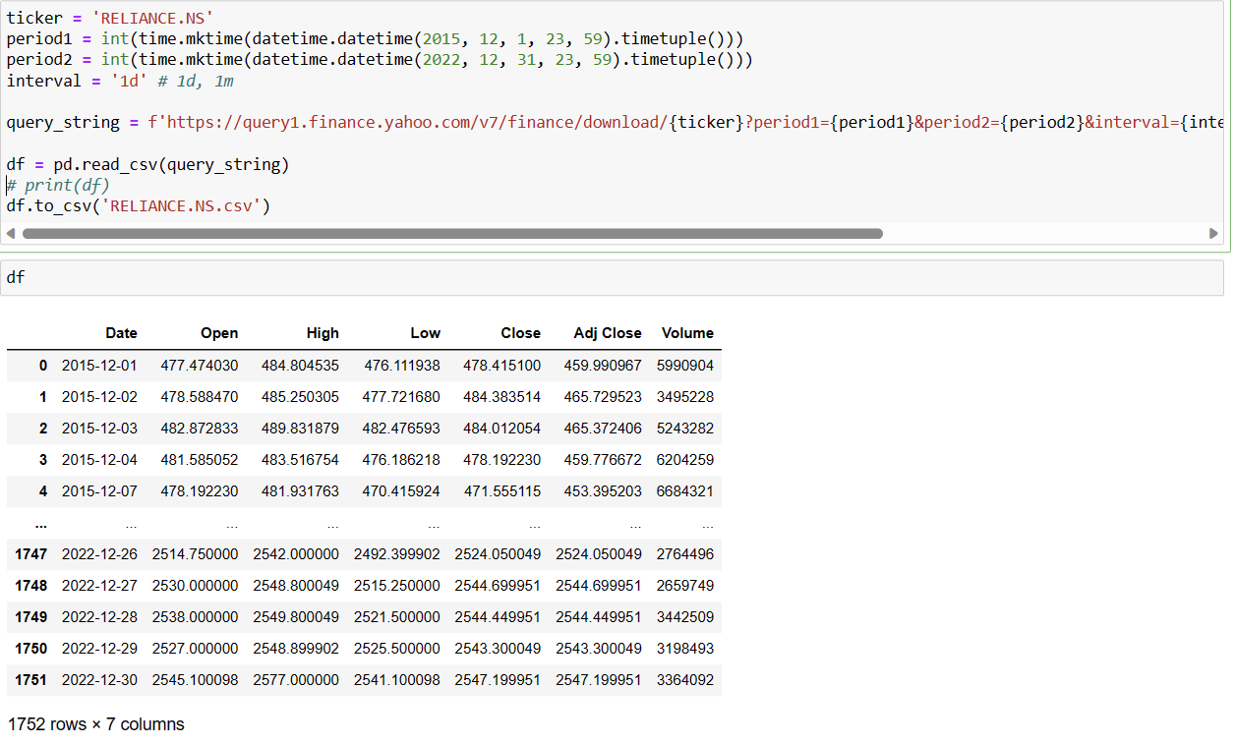
Data Import
There are 1752 rows and 7 columns in this data set

Slide 5
Data Set details
-First load the dataset.
-Dateset are the datas of the range 2015-2022.
-There are 1752 rows and 7 columns in the dataset.
- Columns consists of Date in date format, Open,,Close ,High , Low, Adj.Close are in float datatypes, Volume in integer type.

Slide 6
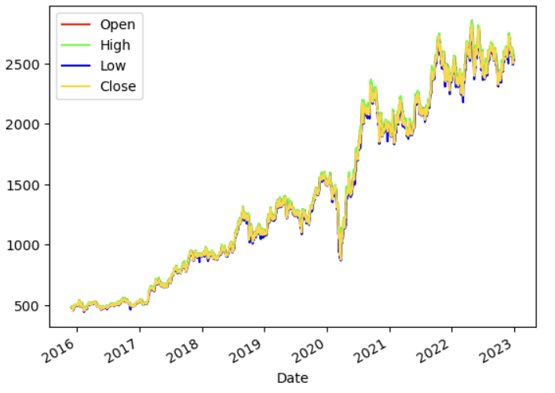
Plot Diagrams
-All Open ,High, Low, Close values seem to be increasing trends within the time frame.

Slide 7
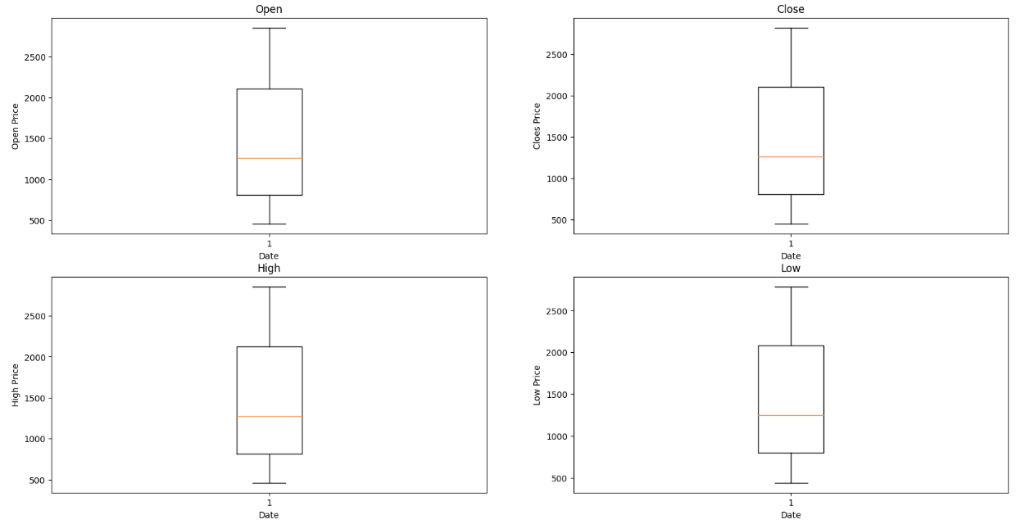
Box plot
TO CHECK THE OUTLIERS
No outlier data is observed from the box plot

Slide 8
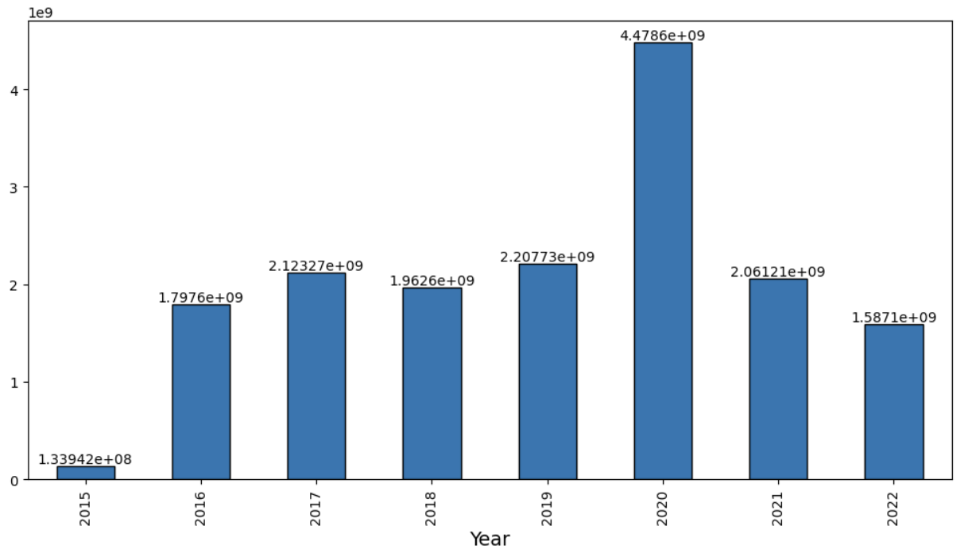
Yearly distribution of the Volume of stocks

Slide 9
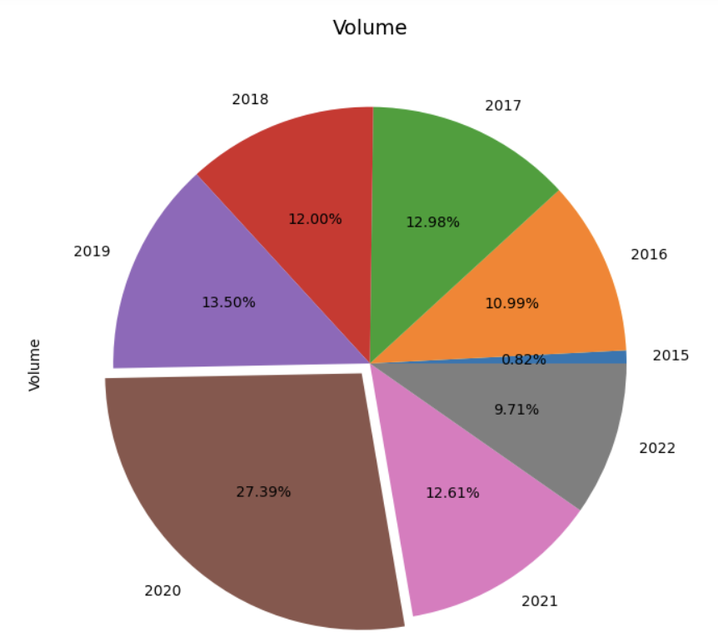
Yearly Volume of stocks distribution in terms of percentage of the total dataset

Slide 10
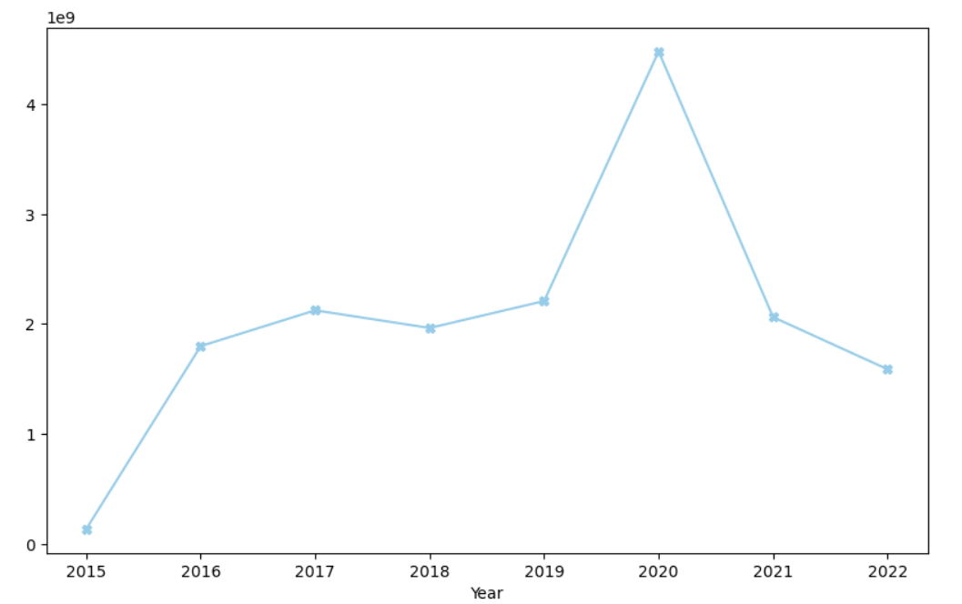
High volume of stocks trading observed in the year 2020

Slide 11
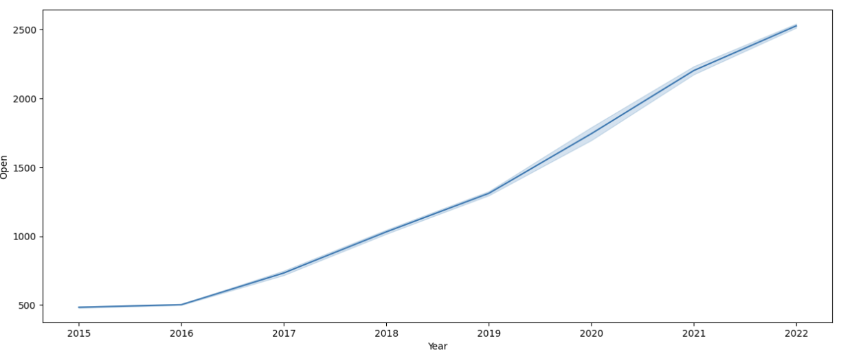
Open stock trade price trends since 2015

Slide 12
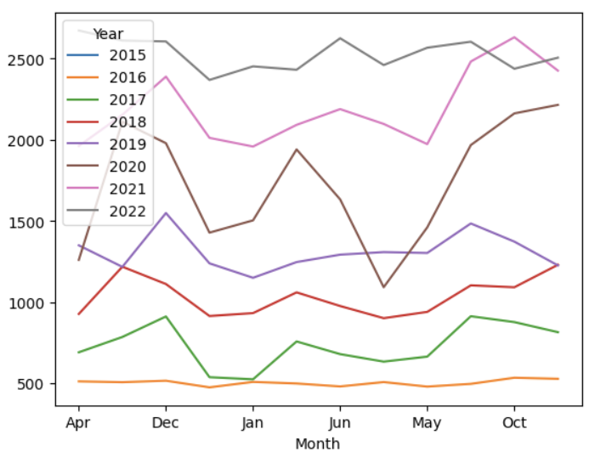
Observation of yearly stock trends with respect to traded month

Slide 13
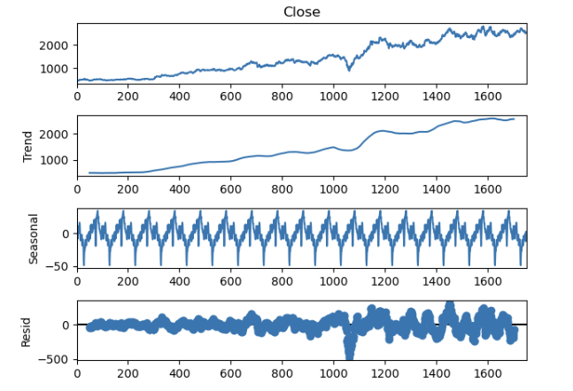
Time series decomposition plot of Closing stock prices

Slide 14
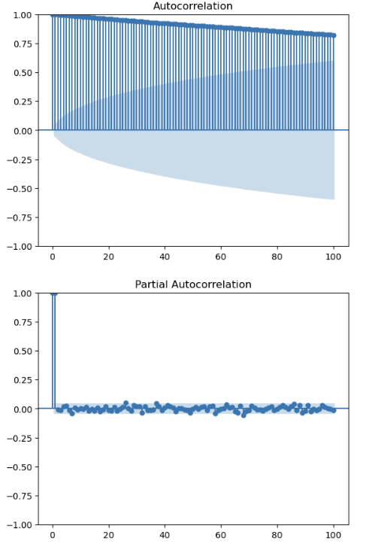
ACF and PACF correlation plot of Closing stock

Slide 15
Conclusion Of EDA Process
- There is no unique and missing values in dataset.
-There is no outliers in data
-While performing EDA we found that there is seasonality and
Trends in our data.
-The given data is was not stationary thus Adfuller method was carried out to stationarize.

Slide 16
MODEL BUILDING
-DATA DRIVEN FORECASTING
-MODEL BASED FORECASTING
-ARIMA
-SARIMAX

Slide 17
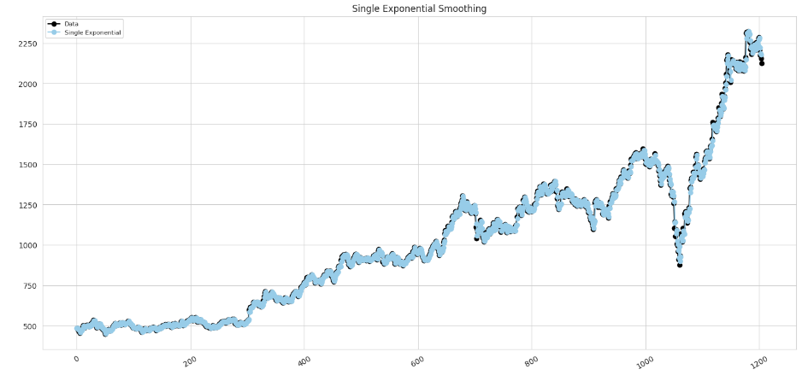
Simple Exponential Method
Exponential Smoothing-Single

Slide 18
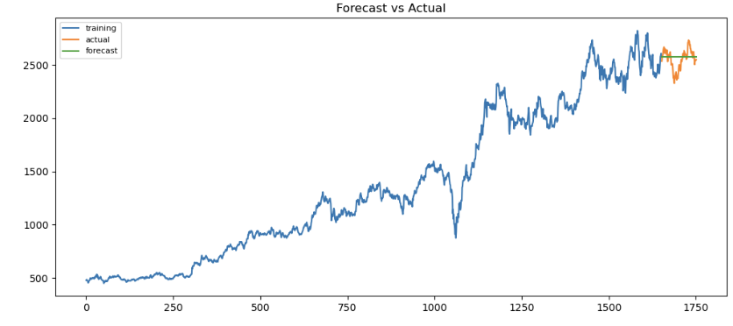
Forecasted vs Actual data graph

Slide 19
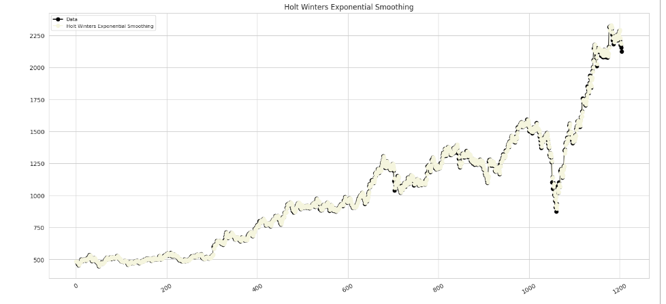
Holt Method
Holt Winters Exponential Smoothing

Slide 20
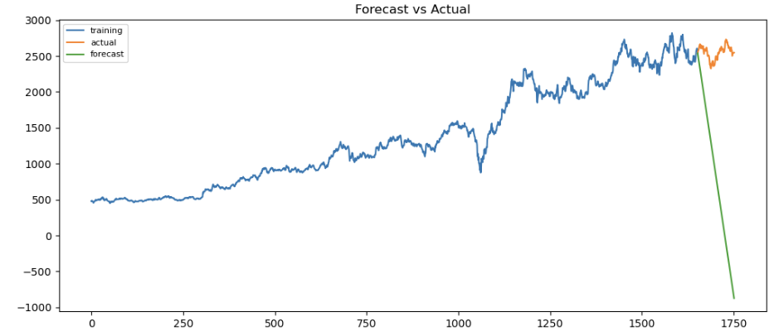
Forecasted vs Actual data graph

Slide 21
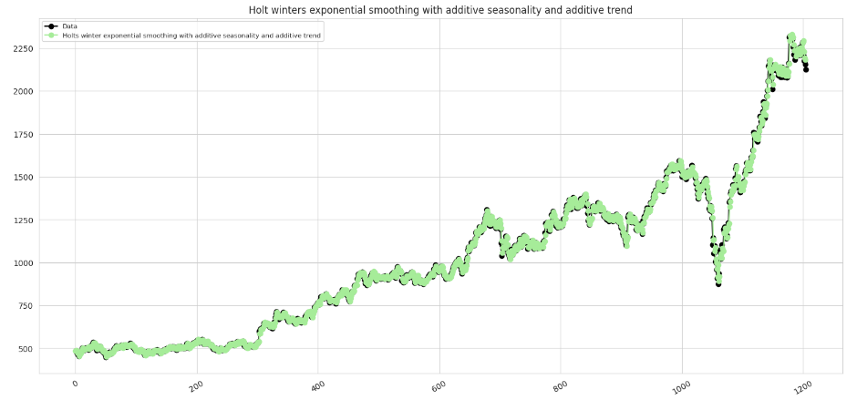
Holt Method
Holt Winters Exponential Smoothing with additive seasonality and additive trend

Slide 22
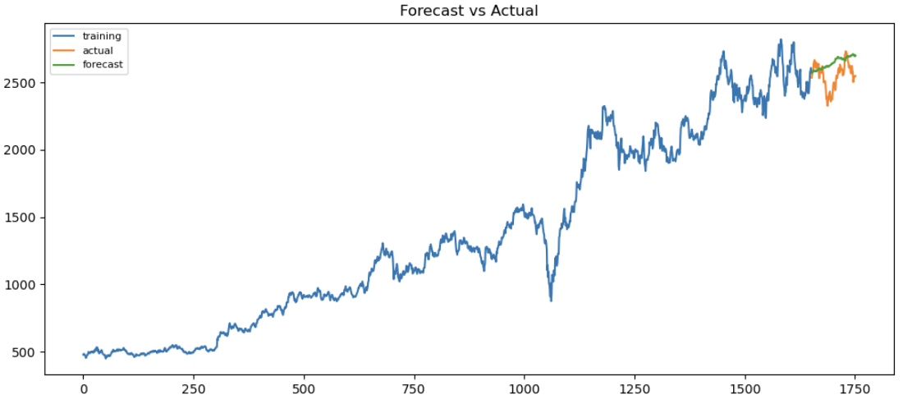
Forecasted vs Actual data graph

Slide 23
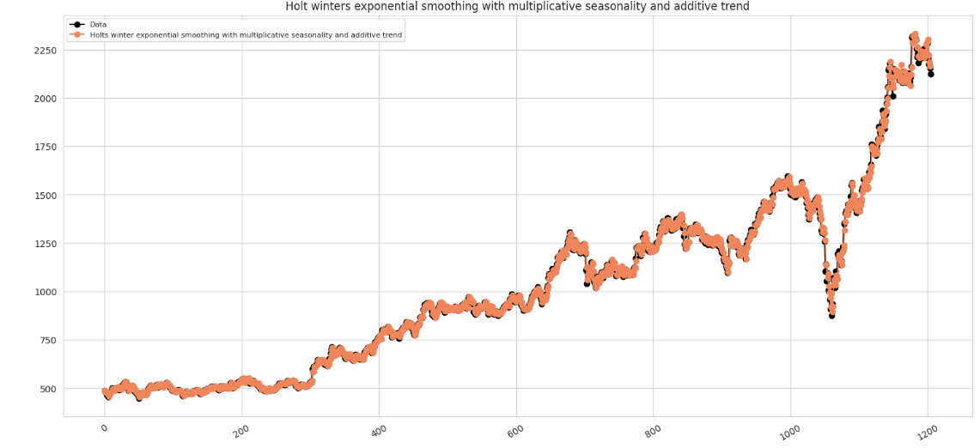
Holt Method
Holt Winters Exponential Smoothing with multiplicative seasonality and additive trend

Slide 24
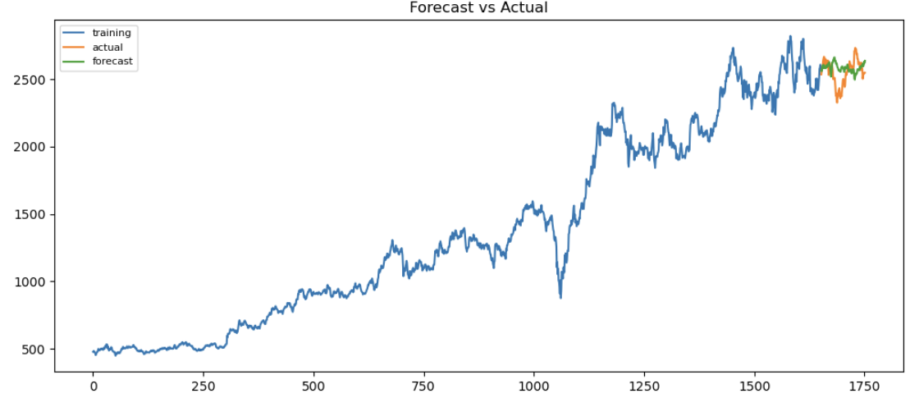
Forecasted vs Actual data graph

Slide 25
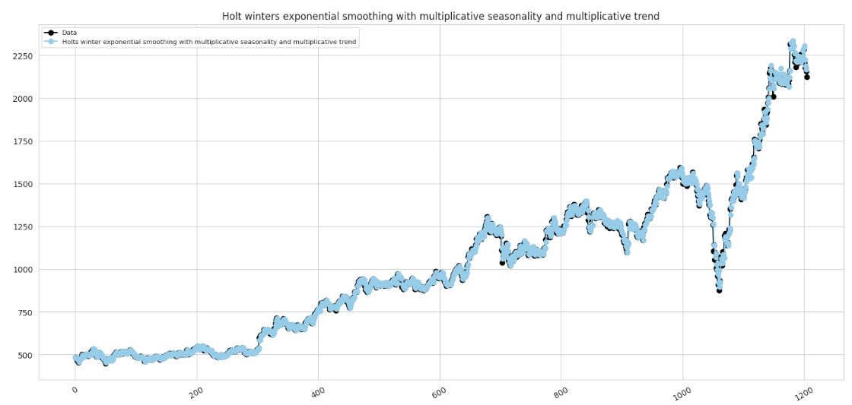
Holt Method
Holt Winters Exponential Smoothing with multiplicative seasonality and multiplicative trend

Slide 26
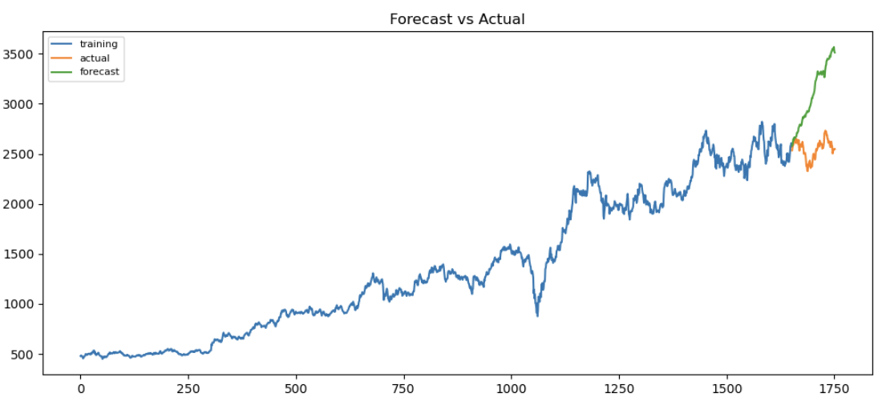
Forecasted vs Actual data graph

Slide 27
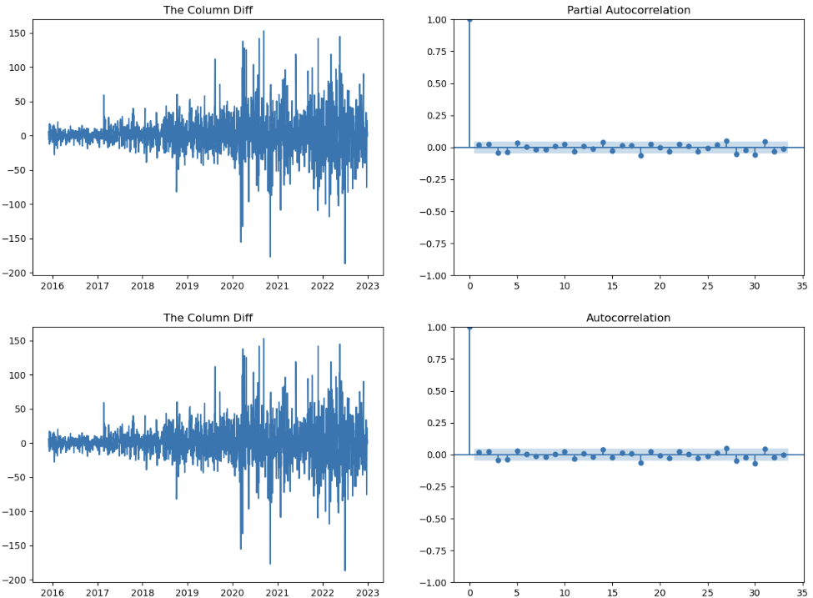
ACF and PACF correlation plot of Closing stock ARIMA

Slide 28
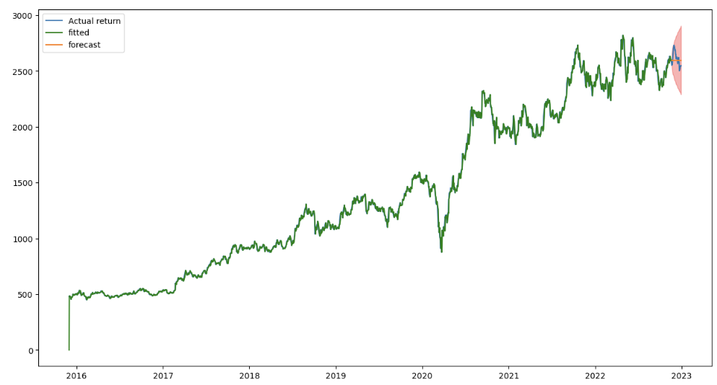
Forecasted vs Actual data graph AREMA

Slide 29
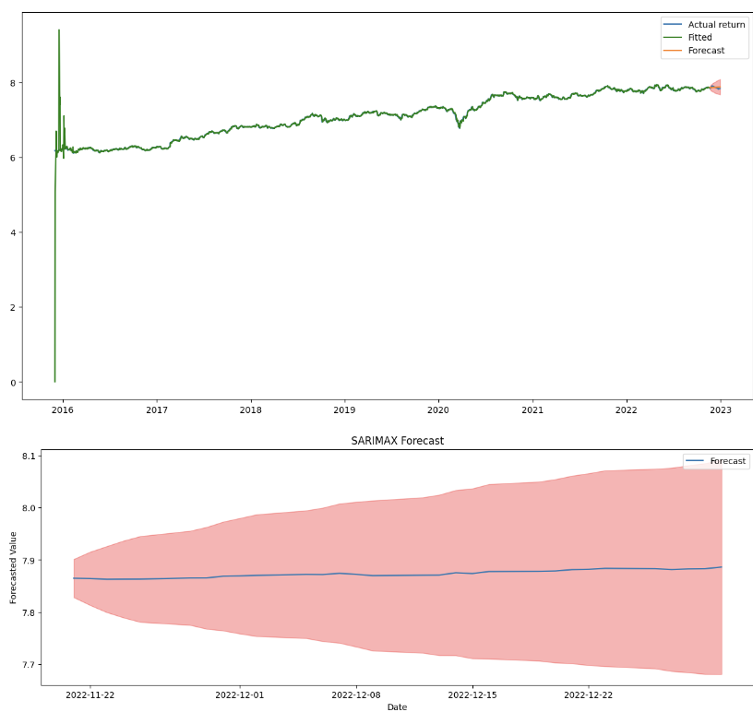
Forecasted vs Actual data graph SARIMAX

Slide 30
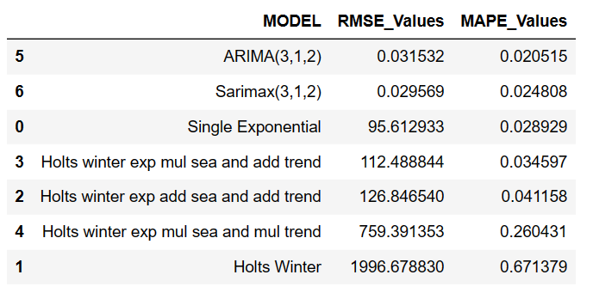
Comparison of Models

Slide 31
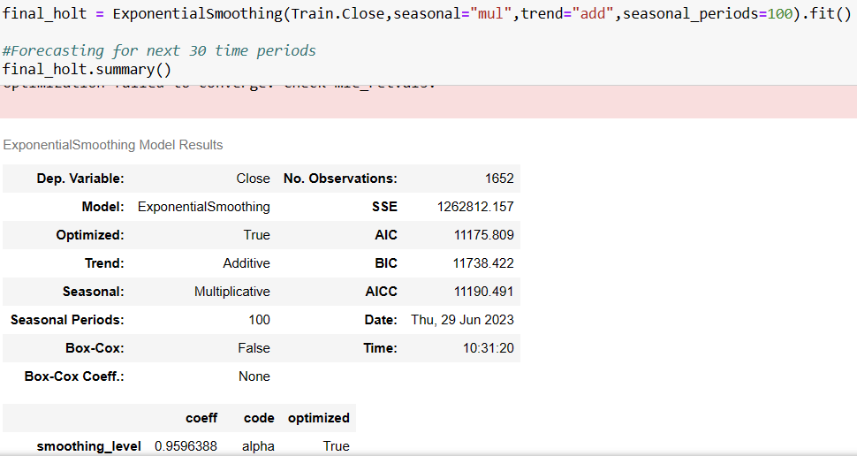
Building Final Model

Slide 32
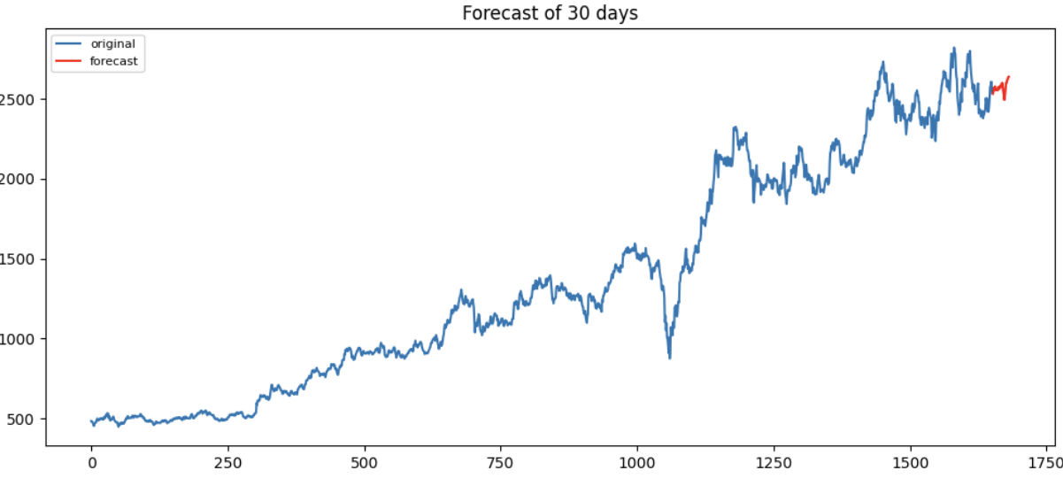
Building Final Model

Slide 33
Deployment of Model
Deployment of Forecasting model by using Streamlit

Slide 34
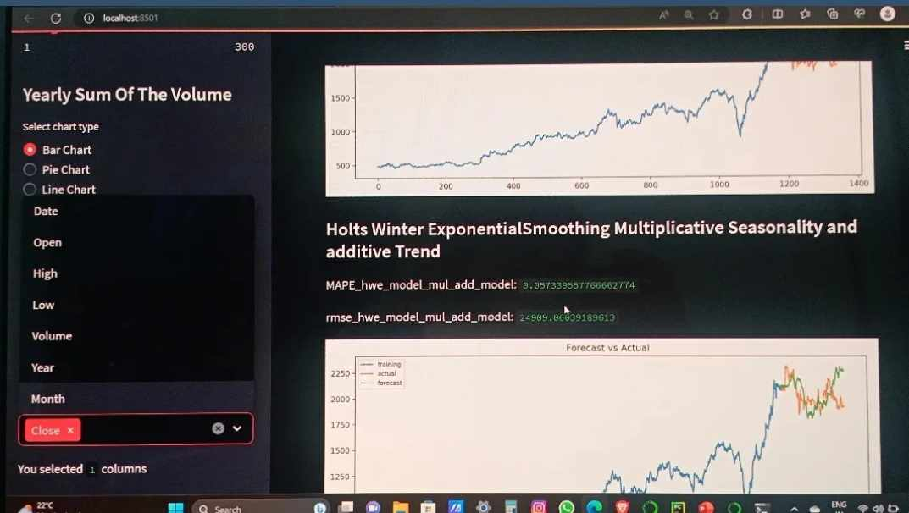
Deployment of Forecasting model by using Streamlit

Slide 35
Thank You

